Slide 1
Families, communities and recovery
Vivienne Evans

Slide 2

What is a family?

Slide 3
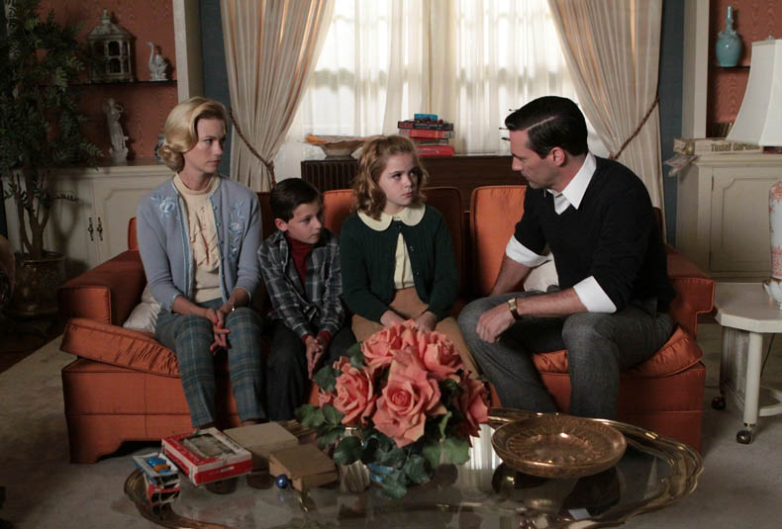
What does a family affected by substance misuse look like?

Slide 4
THE INFLUENCERS
Families affected by addiction problems are important for three significant and related reasons:
Involvement of family members in the treatment of their relatives with addiction problems can enhance positive outcomes
Family members in these circumstances show symptoms of stress that merit help in their own right
Effective treatment of the parent can have positive benefits for the child
Better outcomes for children are achieved if they remain with their families
Notes:
Evidence base … family members help in treatment but need support in their own right which is often forgotten
Need to see drug users as family members not just clients

Slide 5
What does family support mean?
Prevention and early intervention?
Harm minimisation ?
Recovery/reintegration?

Slide 6
Why families?
Rebuilding family relationships is a key constituent of recovery
Families provide vital recovery capital
Families are well placed to help map individualised routes away from drug dependency
Families need to recover too

Slide 7
Key messages
Families are relied upon to provide support without being adequately supported themselves
Families subsidise treatment provision
The welfare system penalises families
Families do not get support when they want to disengage with the drug user
The role of the family needs to be recognised at grassroots level, not just with policy circles
Families want more information

Slide 8
The focus?
Drugs
Families
Communities

Slide 9
Barriers
Delivering family support at a time of economic cutbacks
The role of the state
Outcomes
Localism
Workforce
Confidentiality
Is family support necessarily a good thing?

Slide 10
Opportunities
Coalition’s commitment to a family friendly society
Families as a resource, not a deficit
Re-balanced treatment system; recovery
Big Society
Notes:
Will be advances made over the last few years – families in title of drug strategy for example, be maintained.. Easy to provide the rhetoric

Slide 11
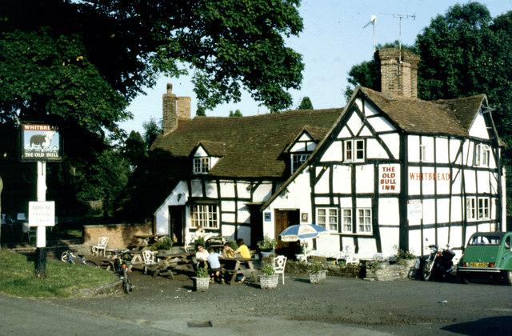

Slide 12
