Slide 1

Street Pastors
‘Making a difference
in the lives of people’

Slide 2
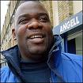
What is a Street Pastors Initiative?
Street Pastors is an interdenominational Church response to urban problems, engaging with people on the streets to care, listen, and dialogue.
Pioneered in London in 2003 by Rev Les Isaac, Director of the Ascension Trust, and has seen some remarkable results, including drops in crime areas where teams have been working.
“There are many people who feel
excluded by society, Street Pastors take
practical hope to the pavement of these
individuals” –
Joel Edwards Director Micah Challenge International

Slide 3
The Urban Trinity
This initiative is called the Urban Trinity; the Church working in partnership with the Police and working in partnership with the Council
Church
Urban Trinity
Council
Police

Slide 4
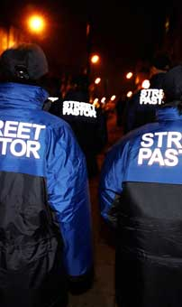
An example of Street Pastors from Chorley
Teams of 4 Christians in uniform + equipment bag
Carrying a wireless radio connected to CCTV
Connected to a Prayer Pastor Mobile
Served by a team Coordinator
Works on a fortnightly/monthly basis
from9.30pm – 2am

Slide 5
Training
The Street Pastors training has received great enthusiasm and the trainees really enjoyed the training sessions which were
informative, stimulating and exciting.

Slide 6
Needs on the Street
‘if you had been around when I was younger I may not have got in this state’ SH 18years
There is a need for people to talk – we are there to listen, care and help, not to preach, just like the Good Samaritan....
Young women who become vulnerable when they are so drunk
Ringing parents for young people, calling taxi’s, taking people to hospital
The teams are using their first hand training
‘”Thanks to Street Pastors our damage figures have been significantly reduced in Coppull’
Chief Inspector Alison Harris
‘Thank you for praying for me as I prepare to leave for Afghanistan next February’
MH 19yrs

Slide 7
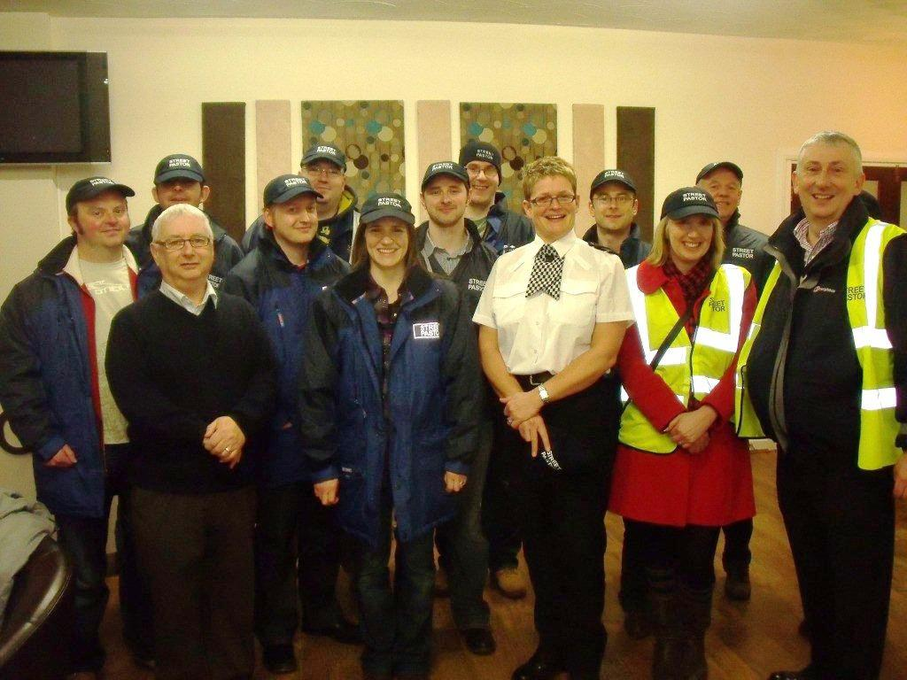
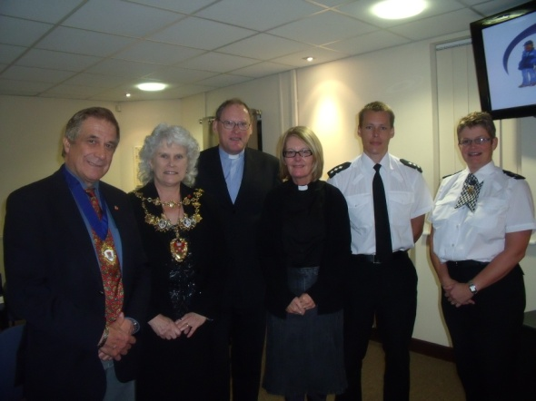
Working in Partnership

Slide 8
Multi Agency Working
“The Street Pastor scheme is about giving something back to our local community, about getting involved at the grass roots level and showing others that together we can make a real difference to our town and our local community. I look forward to supporting the continued good work of the Street Pastors in Chorley”
Lindsay Hoyle
MP
One Body
.....
Many Parts
--Discussion--

Slide 9
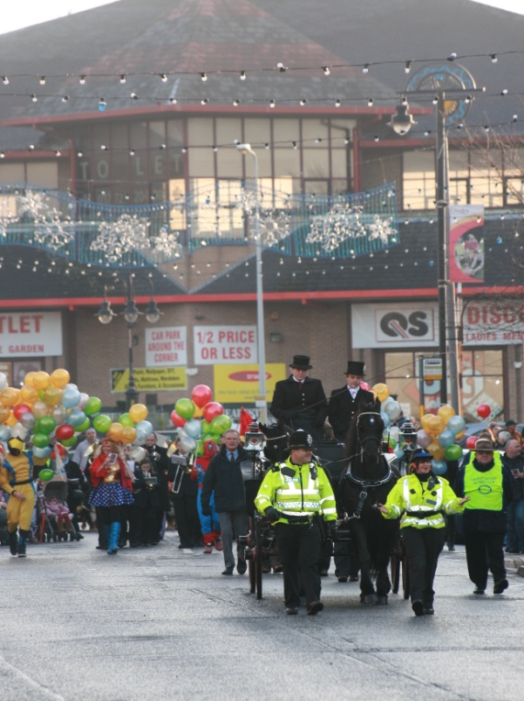
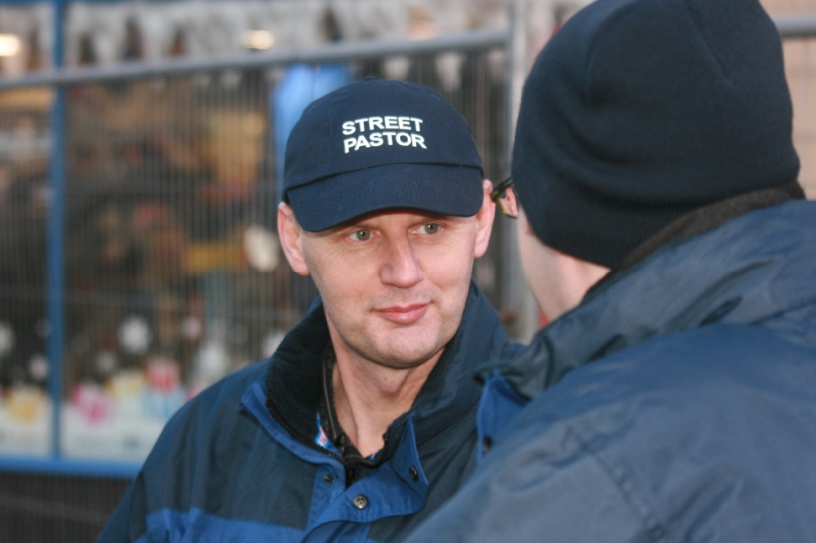
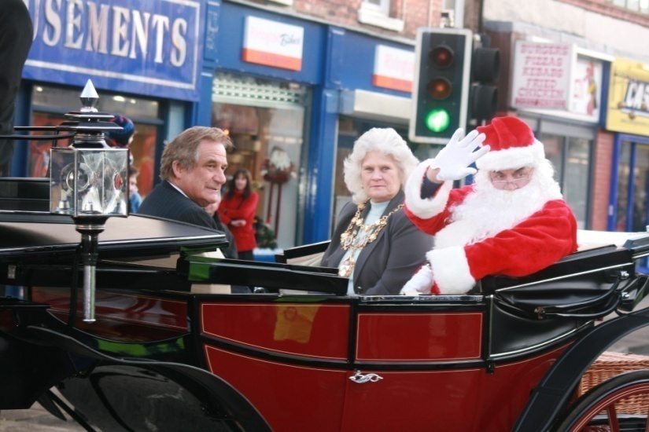
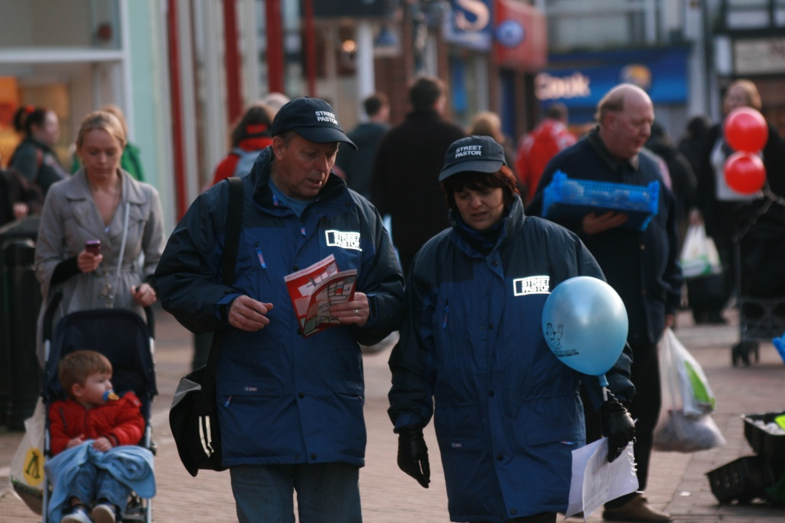
Engaging
Caring
Listening

